Slide 1
Ontario Cycling Tourism Statistics 2015
Summer 2017

Slide 2
This report summarizes key characteristics of visitors and visitor spending of trips in Ontario which included the activity of cycling. Data was sourced from Statistics Canada’s Travel Survey of the Residents of Canada and International Travel Survey, 2015 Some slides include an index table which simplifies the comparison of cycling and total trip statistics. Since total trips equals 100, an index of 105 indicates cycling is 5% higher than total, similarly an index of 90 signifies cycling is 10% lower than total. Index Interpretation less than 80 cycling trips underdeveloped versus total trips 80-120 cycling trips similar to total trips greater than 120 cycling trips overdeveloped versus total trips
2

Slide 3
Visits and Spending
Region | Visits (millions) | Visitor Spending ($ billions)
Ontario Total | 141.9 | 25.4
Ontario Cycling | 1.7 | 0.5
Ontario Cycling proportion of Ontario Total | 1.2% | 2.0%
In 2015, there were 1.7 million cycling visits in Ontario, representing 1.2% of total visits in Ontario
Cycling visitors spent $497 million, accounting for 2.0% of total visitor spending in Ontario
Source: Statistics Canada’s Travel Survey of the Residents of Canada and International Travel Survey 2015; Ontario Ministry of Tourism, Culture and Sport

Slide 4
Cycling and Total Visits by Origin
Cycling vs. Total | Visit Index
Ontario | 101
U.S. | 31
Other Canada | 143
Overseas | 266
Ontario residents accounted for the majority of cycling (86%) and total (86%) visits
U.S. visitors accounted for 2% of cycling visits compared to 8% of total visits
Visitors from Other Canada comprised 7% of cycling visits and 5% of total visits
Overseas visitors accounted for 5% of cycling visits and 2% of total visits
Source: Statistics Canada’s Travel Survey of the Residents of Canada and International Travel Survey 2015; Ontario Ministry of Tourism, Culture and Sport

Slide 5
Cycling and Total Spending by Origin
Cycling vs. Total | Spending Index
Ontario | 112
U.S. | 24
Other Canada | 120
Overseas | 112
Ontario residents accounted for the majority of cycling (61%) and total (55%) spending
U.S. visitors accounted for 3% of cycling spending compared to 14% of total spending
Visitors from Other Canada comprised 11% of cycling spending and 9% of total spending
Overseas visitors accounted for 24% of cycling spending and 22% of total spending
Source: Statistics Canada’s Travel Survey of the Residents of Canada and International Travel Survey 2015; Ontario Ministry of Tourism, Culture and Sport

Slide 6
Ontario Cycling Visitors by Region of Residence
Cycling vs. Total | Visits from Ontario Index
Reg 1 | 100
Reg 2 | 86
Reg 3 | 141
Reg 4 | 105
Reg 5 | 103
Reg 6 | 99
Reg 7 | 154
Reg 8 | 39
Reg 9 | 27
Reg 10 | 69
Reg 11 | 56
Reg 12 | 0
Reg 13 | 89
22% Cycling visitors from Ontario are from Region 5 compared to 22% of total visits, 15% from Region 3 (11% total visits), and 13% from Region 6 (14% total visits)
Note: Ontario origin cycling visitors represented 86% (1.4 M) of visits and 61% ($305 M) of visitor spending
Source: Statistics Canada’s Travel Survey of the Residents of Canada and International Travel Survey 2015; Ontario Ministry of Tourism, Culture and Sport
6

Slide 7
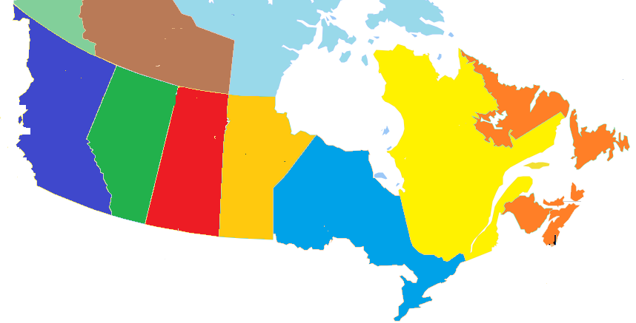
Other Canada Cycling Visitors by Province of Residence
BC
10%
(7%)
Cycling visits
(Total visits)
AB
4%
(7%)
SK
3%
(2%)
MB
15%
(10%)
QC
62%
(66%)
NL/NB/NS/PE
5%
(8%)
62% of Other Canada cycling visitors came from Quebec with 34% from Montreal, similar to total visits (Quebec 66%, Montreal 43%)
Note: Other Canada cycling visitors represented 7% (109,000) of visits and 11% ($54 M) of visitor spending
Source: Statistics Canada’s Travel Survey of the Residents of Canada and International Travel Survey 2015; Ontario Ministry of Tourism, Culture and Sport
7

Slide 8
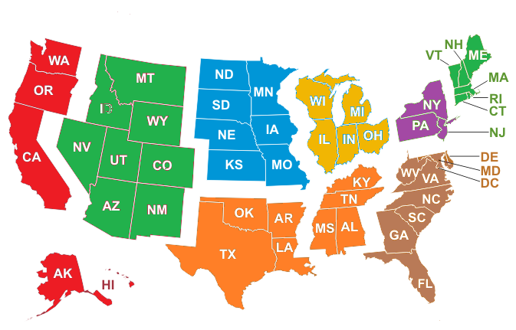
U.S. Cycling Visitors by Region of Residence
Cycling visits
(Total visits)
Mountain
30%
(2%)
West North Central
0%
(5%)
East North Central
41%
(39%)
New England
3%
(4%)
Pacific, Alaska, Hawaii
2%
(3%)
Mid Atlantic
14%
(36%)
South Atlantic
4%
(8%)
South Central
6%
(3%)
41% of U.S. cycling visitors came from East North Central states (Michigan, Ohio, Illinois, Indiana, and Wisconsin) and 30% from Mountain states
Note: U.S. cycling visitors represented 2% (41,000) of visits and 3% ($17 M) of visitor spending
Source: Statistics Canada’s Travel Survey of the Residents of Canada and International Travel Survey 2015; Ontario Ministry of Tourism, Culture and Sport
8

Slide 9
Overseas Cycling Visitors by Country of Residence
Ontario’s 9 overseas target markets represent 52% of overseas cycling visitors versus 54% of total overseas visits
Note: Overseas cycling visitors represented 5% (79,000) of visits and 24% ($120 M) of visitor spending
Source: Statistics Canada’s Travel Survey of the Residents of Canada and International Travel Survey 2015; Ontario Ministry of Tourism, Culture and Sport
9

Slide 10
Destination – Cycling Visits by Region
Cycling vs. Total | Destination Index
Reg 1 | 111
Reg 2 | 76
Reg 3 | 37
Reg 4 | 124
Reg 5 | 57
Reg 6 | 20
Reg 7 | 222
Reg 8 | 264
Reg 9 | 117
Reg 10 | 103
Reg 11 | 111
Reg 12 | 266
Reg 13 | 102
20% of cycling visits took place in Region 7 compared to 9% of total visits, 12% in Region 5 (20% total), and 12% in Region 1 (11% total)
Source: Statistics Canada’s Travel Survey of the Residents of Canada and International Travel Survey 2015; Ontario Ministry of Tourism, Culture and Sport
10

Slide 11
Cycling Visits by Length of Stay
Cycling vs. Total | Length of Stay Index
Same-day | 18
Overnight | 244
Avg # nights | 116
The majority (89%) of cycling visits were overnight visits. For comparison, 36% of total visits in Ontario were overnight visits
The average number of nights spent on cycling visits was 3.7, above Ontario’s average of 3.2 nights
Source: Statistics Canada’s Travel Survey of the Residents of Canada and International Travel Survey 2015; Ontario Ministry of Tourism, Culture and Sport

Slide 12
Cycling $/Trip by Length of Stay
Cycling vs. Total | $/Trip Index
Total | 95
Same-day | 73
Overnight | 167
Cycling visitors spent an average of $299/trip ($179/trip for total trips)
On average, overnight visitors spent 5 times as much per trip as same-day visitors
Total trip spending, not just spending on cycling
Source: Statistics Canada’s Travel Survey of the Residents of Canada and International Travel Survey 2015; Ontario Ministry of Tourism, Culture and Sport

Slide 13
Cycling Spending by Category
Cycling vs. Ontario | Spending Index
Transportation | 79
Accommodation | 137
Food & Beverage | 104
Rec./Entertain. | 111
Retail/Other | 95
The largest proportions of expenditures were spent on Transportation (28% cycling, 36% total) and Food & Beverage (28% cycling, 27% total)
Cycling visitors spent a larger proportion on accommodations, 23%, than total visitors, 17%
Source: Statistics Canada’s Travel Survey of the Residents of Canada and International Travel Survey 2015; Ontario Ministry of Tourism, Culture and Sport

Slide 14
Other Activities done by Cycling Visitors
Activity | Cycling Visit Participation | Index vs Total
Cycling | 100% | 8544
Visit a beach | 50% | 1110
Hiking | 47% | 1071
Canoeing | 30% | 1337
National/Provincial Nature Parks | 29% | 1026
Boating | 27% | 679
Wildlife/Bird watching | 27% | 1179
Camping | 24% | 746
Historic Sites | 16% | 496
Fishing | 14% | 423
Activity | Cycling Visit Participation | Index vs Total
Museums/Art Galleries | 14% | 499
Sightseeing | 10% | 168
Visit Friends or Relatives | 10% | 30
Golfing | 10% | 748
Play a sport | 9% | 436
Restaurant or bar | 9% | 142
Festivals/Fairs | 8% | 295
Cultural Performances | 7% | 178
Shopping | 7% | 80
Theme Parks | 6% | 480
Activity | Cycling Visit Participation | Index vs Total
Zoos/Aquariums/Botanical Gardens | 5% | 331
Casinos | 4% | 139
Sports Events | 3% | 68
Movies | 3% | 286
Hunting | 2% | 425
Indigenous | 1% | 705
Medical/Dental appointment | 1% | 87
Business Meeting/Conference/Seminar | 1% | 25
ATV | 1% | 368
Skiing/Snowboarding | 1% | 114
Cycling visitors participate in a variety of outdoor activities with 50% visiting a beach, 47% hiking, and 30% canoeing
Source: Statistics Canada’s Travel Survey of the Residents of Canada and International Travel Survey 2015; Ontario Ministry of Tourism, Culture and Sport

Slide 15
Main Purpose of Cycling Visit
Cycling vs. Total | Purpose Index
Pleasure | 203
VFR | 56
Business | 13
Other | 13
VFR: Visiting Friends and / or Relatives
Most trips were pleasure trips (72% compared to 35% of total trips)
Other includes shopping, medical, religious, hobby/trade show, etc.
Source: Statistics Canada’s Travel Survey of the Residents of Canada and International Travel Survey 2015; Ontario Ministry of Tourism, Culture and Sport

Slide 16
Cycling Visits by Accommodation Type
Cycling vs. Total | Type Index
Private | 94
Commercial | 68
Campground | 363
The majority (57%) of overnight cycling visits were spent at unpaid accommodations such as private homes and cottages, compared to 61% of total visits
19% of overnight cycling visits were spent in camping/RV facilities versus 5% of total visits
Source: Statistics Canada’s Travel Survey of the Residents of Canada and International Travel Survey 2015; Ontario Ministry of Tourism, Culture and Sport

Slide 17
Cycling Visits by Time of Year
Cycling vs. Total | Quarter Index
Jan-Mar | 15
Apr-Jun | 130
Jul-Sept | 182
Oct-Dec | 30
The largest proportion of trips occur in the summer months with 56% of cycling trips taking place in Jul-Sep versus 31% of total trips
Source: Statistics Canada’s Travel Survey of the Residents of Canada and International Travel Survey 2015; Ontario Ministry of Tourism, Culture and Sport
17

Slide 18
Cycling Visits by Gender
Cycling vs. Total | Gender Index
Male | 107
Female | 92
Males made the majority (57%) of cycling visits. For comparison, 54% of total visits in Ontario were among male visitors
Source: Statistics Canada’s Travel Survey of the Residents of Canada and International Travel Survey 2015; Ontario Ministry of Tourism, Culture and Sport

Slide 19
Cycling Visits by Party Size
Cycling vs. Total | Party Size Index
1 person | 86
2 persons | 79
3+ persons | 156
Avg party size | 125
With children | 162
Avg Party Size 2.9 2.3
With children 20% 12%
37% of cycling visits were among groups of 3 or more people compared to 24% of total visits
20% of cycling visits included children versus 12% of total visits
Source: Statistics Canada’s Travel Survey of the Residents of Canada and International Travel Survey 2015; Ontario Ministry of Tourism, Culture and Sport
19

Slide 20
Domestic Cycling Visitor’s Income
Cycling vs. Total | Income Index
< $50 K | 59
$50 K- $75 K | 103
$75 K - $100 K | 95
$100 K+ | 141
51% of Canadian cycling visitors in Ontario had a household income greater than $100,000 compared to 36% of total visitors
Source: Statistics Canada’s Travel Survey of the Residents of Canada 2015; Ontario Ministry of Tourism, Culture and Sport

Slide 21
Domestic Cycling Visitor’s Education
Cycling vs. Ontario | Education Index
< High School | 80
High School | 78
Some post-secondary | 103
University degree | 115
37% of Canadian cycling visitors in Ontario had a university degree compared with 32% of total visits
Source: Statistics Canada’s Travel Survey of the Residents of Canada 2015; Ontario Ministry of Tourism, Culture and Sport

Slide 22
Cycling Summary
In 2015, there were 1.7 million cycling visits, accounting for 1.2% of total visits in Ontario. Cycling visitors spent $497 million, or 2.0% of total visitor spending in Ontario.
Ontario residents accounted for 86% of visits and 61% of spending, residents of Other Canada accounted for 7% of visits and 11% of spending, U.S. visitors represented 2% of visits and 3% of expenditures, and overseas visitors accounted for 5% of visits and 24% of spending.
22% Cycling visitors from Ontario are from Region 5 compared to 22% of total visits, 15% from Region 3 (11% total visits), and 13% from Region 6 (14% total visits).
20% of cycling visits took place in Region 7 compared to 9% of total visits, 12% in Region 5 (20% total), and 12% in Region 1 (11% total).

Slide 23
Cycling Summary
The majority (89%) of cycling visits were overnight visits. For comparison, 36% of total visits in Ontario were overnight visits. The average number of nights spent on cycling visits was 3.7, above Ontario’s average of 3.2 nights.
Cycling visitors spent an average of $299/trip ($179/trip for total trips). On average, overnight visitors spent five times as much per trip as same-day visitors.
The largest proportions of expenditures were spent on Transportation (28% cycling, 36% total) and Food & Beverage (28% cycling, 27% total). Cycling visitors spent a larger proportion on accommodations, 23%, than total visitors, 17%.
Cycling visitors participate in a variety of outdoor activities with 50% visiting a beach, 47% hiking, and 30% canoeing.
Most trips were pleasure trips (72% compared to 35% of total trips).

Slide 24
Cycling Summary
The majority (57%) of overnight cycling visits were spent at unpaid accommodations such as private homes and cottages, compared to 61% of total visits. 19% of overnight cycling visits were spent in camping/RV facilities versus 5% of total visits.
The largest proportion of trips occur in the summer months with 56% of cycling trips taking place in Jul-Sep versus 31% of total trips.
37% of cycling visits were among groups of 3 or more people compared to 24% of total visits. 20% of cycling visits included children versus 12% of total visits.
51% of Canadian cycling visitors in Ontario had a household income greater than $100,000 compared to 36% of total visitors.
37% of Canadian cycling visitors in Ontario had a university degree compared with 32% of total visits.

