Slide 1
Ontario Cycling Tourism Statistics 2014
Tourism Research Unit
Winter 2017

Slide 2
This report summarizes key characteristics of visitors and visitor spending of trips in Ontario which included the activity of cycling. Data was sourced from Statistics Canada’s Travel Survey of the Residents of Canada and International Travel Survey, 2014 Some slides include an index table which simplifies the comparison of cycling and total trip statistics. Since total trips equals 100, an index of 105 indicates cycling is 5% higher than total, similarly an index of 90 signifies cycling is 10% lower than total. Index Interpretation less than 80 cycling trips underdeveloped versus total trips 80-100 cycling trips similar to total trips greater than 120 cycling trips overdeveloped versus total trips
2

Slide 3
Visits and Spending
Region | Visits (millions) | Visitor Spending ($ billions)
Ontario Total | 139.5 | 23.9
Ontario Cycling | 1.7 | 0.4
Ontario Cycling proportion of Ontario Total | 1.2% | 1.8%
In 2014, there were 1.7 million cycling visits in Ontario, representing 1.2% of total visits in Ontario
Cycling visitors in spent $428 million, accounting for 1.8% of total visitor spending in Ontario
Source: Statistics Canada’s Travel Survey of the Residents of Canada and International Travel Survey 2014; Ontario Ministry of Tourism, Culture and Sport

Slide 4
Cycling and Total Visits by Origin
Cycling vs. Total | Visit Index
Ontario | 102
U.S. | 29
Other Canada | 150
Overseas | 198
Ontario residents accounted for the majority of cycling (88%) and total (86%) visits
U.S. visitors accounted for 2% of cycling visits compared to 8% of total visits
Visitors from Other Canada comprised 6% of cycling visits and 4% of total visits
Overseas visitors accounted for 3% of cycling visits and 2% of total visits
Source: Statistics Canada’s Travel Survey of the Residents of Canada and International Travel Survey 2014; Ontario Ministry of Tourism, Culture and Sport

Slide 5
Cycling and Total Spending by Origin
Cycling vs. Total | Spending Index
Ontario | 117
U.S. | 16
Other Canada | 116
Overseas | 101
Ontario residents accounted for the majority of cycling (67%) and total (57%) spending
U.S. visitors accounted for 2% of cycling spending compared to 14% of total spending
Visitors from Other Canada comprised 10% of cycling spending and 9% of total spending
Overseas visitors accounted for 21% of cycling spending and 21% of total spending
Source: Statistics Canada’s Travel Survey of the Residents of Canada and International Travel Survey 2014; Ontario Ministry of Tourism, Culture and Sport

Slide 6
Ontario Cycling Visitors by Region of Residence
Cycling vs. Total | Visits from Ontario Index
Reg 1 | 88
Reg 2 | 87
Reg 3 | 109
Reg 4 | 83
Reg 5 | 162
Reg 6 | 120
Reg 7 | 75
Reg 8 | 54
Reg 9 | 17
Reg 10 | 59
Reg 11 | 41
Reg 12 | 5
Reg 13 | 72
35% Cycling visitors from Ontario are from Region 5 compared to 22% of total visits, 15% from Region 6 (13% total visits), and 12% from Region 3 (11% total visits)
Note: Ontario origin cycling visitors represented 88% (1.5 M) of visits and 67% ($287 M) of visitor spending
Source: Statistics Canada’s Travel Survey of the Residents of Canada and International Travel Survey 2014; Ontario Ministry of Tourism, Culture and Sport
6

Slide 7
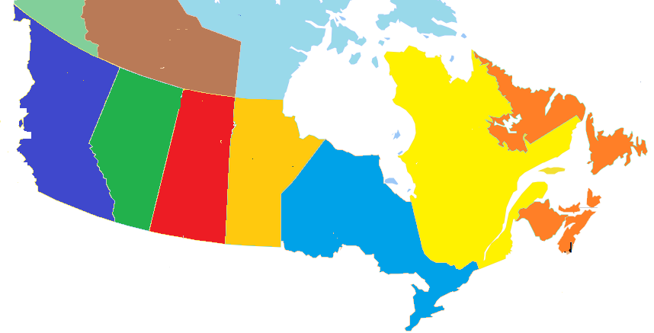
Other Canada Cycling Visitors by Province of Residence
BC
10%
(7%)
Cycling visits
(Total visits)
AB
2%
(6%)
SK
1%
(2%)
MB
12%
(10%)
QC
70%
(67%)
NL/NB/NS/PE
5%
(8%)
70% of Other Canada cycling visitors came from Quebec with 38% from Montreal, similar to total visits (Quebec 67%, Montreal 44%)
Note: Other Canada cycling visitors represented 6% (110,000) of visits and 10% ($42 M) of visitor spending
Source: Statistics Canada’s Travel Survey of the Residents of Canada and International Travel Survey 2014; Ontario Ministry of Tourism, Culture and Sport
7

Slide 8
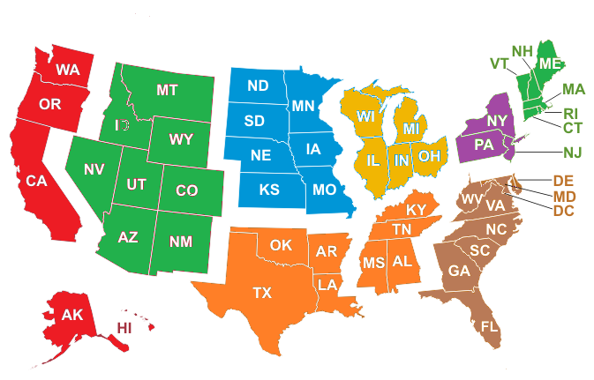
U.S. Cycling Visitors by Region of Residence
Cycling visits
(Total visits)
Mountain
25%
(2%)
West North Central
3%
(5%)
East North Central
42%
(38%)
New England
9%
(4%)
Pacific, Alaska, Hawaii
1%
(3%)
Mid Atlantic
12%
(36%)
South Atlantic
3%
(8%)
South Central
5%
(4%)
42% of U.S. cycling visitors came from East North Central states (Michigan, Ohio, Illinois, Indiana, and Wisconsin) and 25% form Mountain states
Note: U.S. cycling visitors represented 2% (37,000) of visits and 2% ($9 M) of visitor spending
Source: Statistics Canada’s Travel Survey of the Residents of Canada and International Travel Survey 2014; Ontario Ministry of Tourism, Culture and Sport
8

Slide 9
Overseas Cycling Visitors by Country of Residence
Ontario’s 9 overseas target markets represent 43% of overseas cycling visitors versus 54% of total overseas visits
Note: Overseas cycling visitors represented 3% (57,000) of visits and 21% ($89 M) of visitor spending
Source: Statistics Canada’s Travel Survey of the Residents of Canada and International Travel Survey 2014; Ontario Ministry of Tourism, Culture and Sport
9

Slide 10
Destination – Cycling Visits by Region
Cycling vs. Total | Destination Index
Reg 1 | 57
Reg 2 | 49
Reg 3 | 43
Reg 4 | 113
Reg 5 | 58
Reg 6 | 30
Reg 7 | 272
Reg 8 | 283
Reg 9 | 76
Reg 10 | 37
Reg 11 | 137
Reg 12 | 362
Reg 13 | 71
25% of cycling visits took place in Region 7 compared to 9% of total visits, 12% in Region 5 (20% total), and 11% in each of Region 8 and 12
Source: Statistics Canada’s Travel Survey of the Residents of Canada and International Travel Survey 2014; Ontario Ministry of Tourism, Culture and Sport
10

Slide 11
Cycling Visits by Length of Stay
Cycling vs. Total | Length of Stay Index
Same-day | 27
Overnight | 227
Avg # nights | 109
The majority (83%) of cycling visits were overnight visits. For comparison, 36% of total visits in Ontario were overnight visits
The average number of nights spent on cycling visits was 3.4, slightly above Ontario’s average of 3.1 nights
Source: Statistics Canada’s Travel Survey of the Residents of Canada and International Travel Survey 2014; Ontario Ministry of Tourism, Culture and Sport

Slide 12
Cycling $/Trip by Length of Stay
Cycling vs. Total | $/Trip Index
Total | 149
Same-day | 52
Overnight | 92
Cycling visitors spent an average of $255/trip ($171/trip for total trips)
On average, overnight visitors spent seven times as much per trip as same-day visitors
Total trip spending, not just spending on cycling
Source: Statistics Canada’s Travel Survey of the Residents of Canada and International Travel Survey 2014; Ontario Ministry of Tourism, Culture and Sport

Slide 13
Cycling Spending by Category
Cycling vs. Ontario | Spending Index
Transportation | 88
Accommodation | 129
Food & Beverage | 97
Rec./Entertain. | 86
Retail/Other | 110
The largest proportions of expenditures were spent on Transportation (33% cycling, 37% total) and Food & Beverage (26% cycling, 27% total)
Cycling visitors spent a larger proportion on accommodations, 21%, than total visitors, 16%
Source: Statistics Canada’s Travel Survey of the Residents of Canada and International Travel Survey 2014; Ontario Ministry of Tourism, Culture and Sport

Slide 14
Other Activities done by Cycling Visitors
Activity | Cycling Visit Participation | Index vs Total
Cycling | 100% | 8293
Visit a beach | 49% | 1049
Hiking | 38% | 945
Boating | 37% | 795
Camping | 28% | 817
National/Provincial Nature Parks | 25% | 847
Wildlife/Bird watching | 22% | 1011
Fishing | 20% | 567
Historic Sites | 14% | 439
Museums/Art Galleries | 13% | 425
Activity | Cycling Visit Participation | Index vs Total
Play a sport | 11% | 581
Golfing | 8% | 613
Festivals/Fairs | 8% | 281
Cultural Performances | 6% | 163
Visit Family or Relatives | 6% | 18
Shopping | 6% | 65
Restaurant or bar | 6% | 101
Sightseeing | 6% | 105
Sports Events | 4% | 109
Zoos/Aquariums/Botanical Gardens | 3% | 219
Activity | Cycling Visit Participation | Index vs Total
Casinos | 3% | 100
Theme Parks | 2% | 182
Movies | 1% | 140
Hunting | 1% | 246
Indigenous | 0% | 317
Business Meeting/Conference/Seminar | 0% | 7
ATV | 0% | 49
Medical/Dental appointment | 0% | 3
Snowmobiling | 0% | 8
Skiing/Snowboarding | 0% | 1
Cycling visitors participate in a variety of outdoor activities with 49% visiting a beach, 38% hiking, and 37% boating
Source: Statistics Canada’s Travel Survey of the Residents of Canada and International Travel Survey 2014; Ontario Ministry of Tourism, Culture and Sport

Slide 15
Main Purpose of Cycling Visit
Cycling vs. Total | Purpose Index
Pleasure | 208
VFR | 58
Business | 8
Other | 10
VFR: Visiting Friends and / or Relatives
Most trips were pleasure trips (72% compared to 34% of total trips)
Other includes shopping, medical, religious, hobby/trade show, etc.
Source: Statistics Canada’s Travel Survey of the Residents of Canada and International Travel Survey 2014; Ontario Ministry of Tourism, Culture and Sport

Slide 16
Cycling Visits by Accommodation Type
Cycling vs. Total | Type Index
Private | 86
Commercial | 62
Campground | 475
The majority (54%) of overnight cycling visits were spent at unpaid accommodations such as private homes and cottages, compared to 63% of total visits
25% of overnight cycling visits were spent in camping/RV facilities versus 5% of total visits
Source: Statistics Canada’s Travel Survey of the Residents of Canada and International Travel Survey 2014; Ontario Ministry of Tourism, Culture and Sport

Slide 17
Cycling Visits by Time of Year
Cycling vs. Total | Quarter Index
Jan-Mar | 7
Apr-Jun | 139
Jul-Sept | 184
Oct-Dec | 28
The largest proportion of trips occur in the summer months with 56% of cycling trips taking place in Jul-Sep versus 30% of total trips
Source: Statistics Canada’s Travel Survey of the Residents of Canada and International Travel Survey 2014; Ontario Ministry of Tourism, Culture and Sport
17

Slide 18
Cycling Visits by Gender
Cycling vs. Total | Gender Index
Male | 110
Female | 92
Males made the majority (58%) of cycling visits. For comparison, 53% of total visits in Ontario were among male visitors
Source: Statistics Canada’s Travel Survey of the Residents of Canada and International Travel Survey 2014; Ontario Ministry of Tourism, Culture and Sport

Slide 19
Cycling Visits by Party Size
Cycling vs. Total | Party Size Index
1 person | 68
2 persons | 66
3+ persons | 197
Avg party size | 148
With children | 238
Avg Party Size 3.6 2.4
With children 31% 13%
50% of cycling visits were among groups of 3 or more people compared to 25% of total visits
31% of cycling visits included children versus 13% of total visits
Source: Statistics Canada’s Travel Survey of the Residents of Canada and International Travel Survey 2014; Ontario Ministry of Tourism, Culture and Sport
19

Slide 20
Domestic Cycling Visitor’s Income
Cycling vs. Total | Income Index
< $50 K | 61
$50 K- $75 K | 68
$75 K - $100 K | 97
$100 K+ | 136
48% of Canadian cycling visitors in Ontario had an household income greater than $100,000 compared to 35% of total visitors
Source: Statistics Canada’s Travel Survey of the Residents of Canada 2014; Ontario Ministry of Tourism, Culture and Sport

Slide 21
Domestic Cycling Visitor’s Education
Cycling vs. Ontario | Education Index
< High School | 73
High School | 83
Some post-secondary | 95
University degree | 125
39% of Canadian cycling visitors in Ontario had a university degree compared with 31% of total visits
Source: Statistics Canada’s Travel Survey of the Residents of Canada 2014; Ontario Ministry of Tourism, Culture and Sport

Slide 22
Cycling Summary
In 2014, there were 1.7 million cycling visits, accounting for 1.2% of total visits to Ontario. Cycling visitors spent $428 million, or 1.8% of total visitor spending in Ontario.
Ontario residents accounted for 88% of visits and 67% of spending, residents of Other Canada accounted for 6% of visits and 10% of spending, U.S. visitors represented 2% of visits and 2% of expenditures, and overseas visitors accounted for 3% of visits and 21% of spending
35% Cycling visitors from Ontario are from Region 5 compared to 22% of total visits, 15% from Region 6 (13% total visits), and 12% from Region 3 (11% total visits)
25% of cycling visits took place in Region 7 compared to 9% of total visits, 12% in Region 5 (20% total), and 11% in each of Region 8 and 12

Slide 23
Cycling Summary
The majority (83%) of cycling visits were overnight visits. For comparison, 36% of total visits in Ontario were overnight visits. The average number of nights spent on cycling visits was 3.4, slightly above Ontario’s average of 3.1 nights
Cycling visitors spent an average of $255/trip ($171/trip for total trips). On average, overnight visitors spent seven times as much per trip as same-day visitors
The largest proportions of expenditures were spent on Transportation (33% cycling, 37% total) and Food & Beverage (26% cycling, 27% total). Cycling visitors spent a larger proportion on accommodations, 21%, than total visitors, 16%
Cycling visitors participate in a variety of outdoor activities with 49% visiting a beach, 38% hiking, and 37% boating
Most trips were pleasure trips (72% compared to 34% of total trips)

Slide 24
Cycling Summary
The majority (54%) of overnight cycling visits were spent at unpaid accommodations such as private homes and cottages, compared to 63% of total visits. 25% of overnight cycling visits were spent in camping/RV facilities versus 5% of total visits
The largest proportion of trips occur in the summer months with 56% of cycling trips taking place in Jul-Sep versus 30% of total trips
50% of cycling visits were among groups of 3 or more people compared to 25% of total visits. 31% of cycling visits included children versus 13% of total visits
48% of Canadian cycling visitors in Ontario had an household income greater than $100,000 compared to 35% of total visitors
39% of Canadian cycling visitors in Ontario had a university degree compared with 31% of total visits

Slide 25
Appendix
25

Slide 26
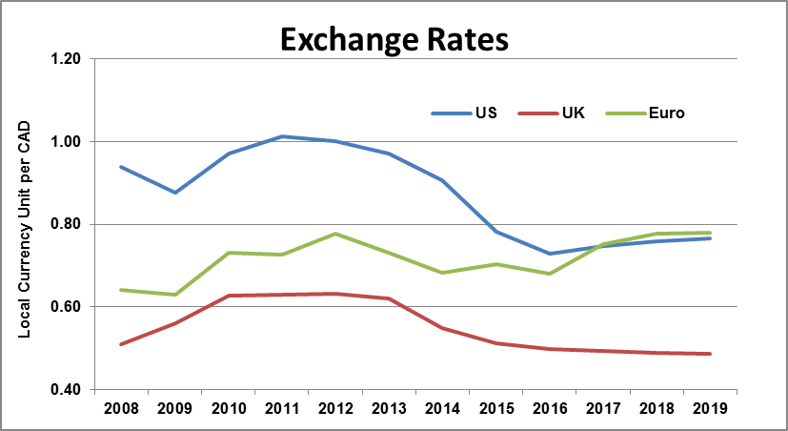
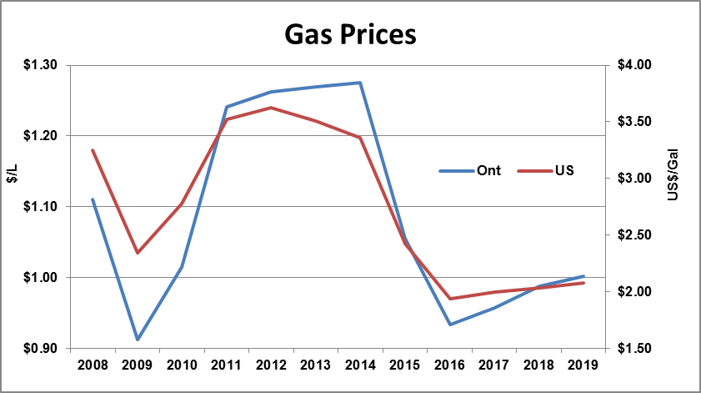
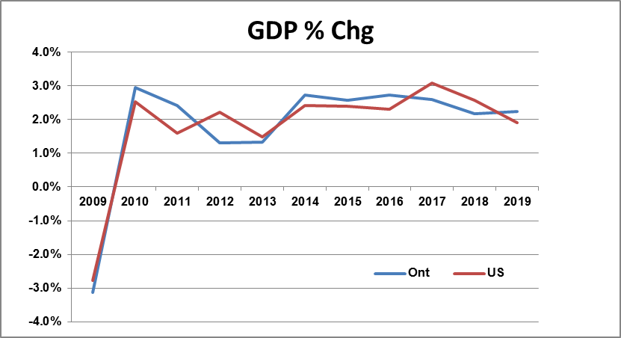
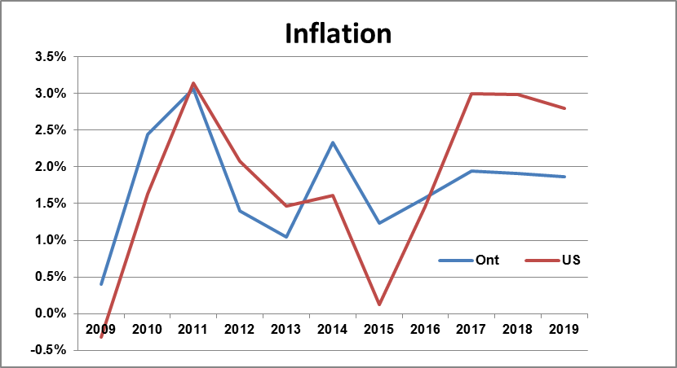
Economic Indicators
Source: Oxford Economics; Ontario Ministry of Tourism, Culture and Sport
26

Slide 27
2014 Notable Events
February 7–23 – The XXII Olympic Winter Games are held in Sochi, Russia
March 8 – Malaysia Airlines Flight 370, a Boeing 777 airliner en route to Beijing from Kuala Lumpur, disappears over the Gulf of Thailand with 239 people on board. The aircraft is presumed to have crashed into the Indian Ocean
Ebola Epidemic becomes Global Health Crisis
June 12 – July 13 – The 2014 FIFA World Cup are held in Brazil
July 23 - August 3 - XX Commonwealth Games are held in Glasgow, Scotland
World oil prices plunge to historic low
October 22 - In the shootings at Parliament Hill, a gunman fatally shot a Canadian Forces soldier at the National War Memorial in Ottawa, then entered the Parliament buildings where he was killed by security forces
27

Slide 28
Ontario Tourism
28

Slide 29
Economic Impact of Tourism in Ontario 2014
Tourism receipts totalled $29.8 billion
Total GDP (direct, indirect and induced) generated by tourism related spending amounted to $26.6 billion, 3.7% of Ontario's GDP
The total tourism employment impact (direct, indirect and induced) of tourism receipts reached 371,968 jobs, accounting for 5.3% of Ontario’s total employment
Total tax revenues (direct, indirect and induced) from tourism for all levels of government amounted to $12.8 billion. $6.4 billion were federal tax revenues, $5.1 billion were provincial and $1.3 billion were municipal
Tourism is an important export industry, contributing $8.5 billion to Ontario's foreign earnings
29

Slide 30
Ontario Visits and Spending by Origin
Ontario | 2014 | vs 2012
Visits | 139.5M | -1.0%
Visitor Spending | $23.9B | 5.1%
In 2014, there were 139.5 million visits in Ontario and visitors spent $23.9 billion
Ontario residents account for the majority of visits and spending
U.S. visitors represent 8% of visits and 14% of expenditures
Overseas visitors account for 2% of visits and 21% of spending
Source: Statistics Canada’s Travel Survey of the Residents of Canada and International Travel Survey 2014; Ontario Ministry of Tourism, Culture and Sport
30

Slide 31
Destination - Visits and Spending by Region
Tourism Regions
1 | Southwest Ontario
2 | Niagara Falls Canada
3 | Hamilton, Halton, Brant
4 | Huron, Perth, Waterloo, Wellington
5 | Greater Toronto Area
6 | York, Durham, Hills of Headwaters
7 | Bruce Peninsula, Southern Georgian Bay and Lake Simcoe
8 | Kawartha and Northumberland
9 | South Eastern Ontario
10 | Ottawa and Countryside
11 | Haliburton Highlands to the Ottawa Valley
12 | Muskoka, Parry Sound and Algonquin Park
13 | Northern Ontario
Region 5 is the largest region representing 20% of visits and 35% of spending
Source: Statistics Canada’s Travel Survey of the Residents of Canada and International Travel Survey 2014; Ontario Ministry of Tourism, Culture and Sport
31

Slide 32
Ontario Summary
In 2014, there were 139.5 million visits in Ontario and visitors spent $23.9 billion. Visits were down 1.0%, while spending grew 5.1% compared to 2013
Ontario residents accounted for the majority of visits (86%) and spending (57%)
U.S. visitors represented 8% of visits and 14% of expenditures
Overseas visitors accounted for 2% of visits and 21% of spending
Region 5 (GTA) is the largest Region representing 20% of visits and 35% of spending
Visitors spent an average of $171/trip in Ontario
The largest proportions of expenditures were spent on Transportation (37%) and Food & Beverage (27%)
32

Slide 33
Ontario Summary
67% of Other Canada visitors came from Quebec with 44% from Montreal
38% of U.S. visitors come from East North Central (Michigan, Ohio, Illinois, Indiana, and Wisconsin) and 36% form Mid Atlantic (New York, Pennsylvania, and New Jersey)
Ontario’s 9 target overseas markets (U.K., Japan, Germany, France, Mexico, India, China, South Korea and Brazil) represented 54% of overseas visitors to Ontario. The U.K. was the leading overseas source market at 12% of overseas visits
64% of visits were same-day visits driven by Ontario residents
Most trips were to visit friends and relatives (45%) or for pleasure (34%)
The majority of overnight visitors stayed in private homes (63%) except U.S. visitors who are more likely to stay at a hotel/motel (46%)
33

Slide 34
We Know. Just Ask.
tourism.research@ontario.ca
(416) 325-8287
34

